Slide 1
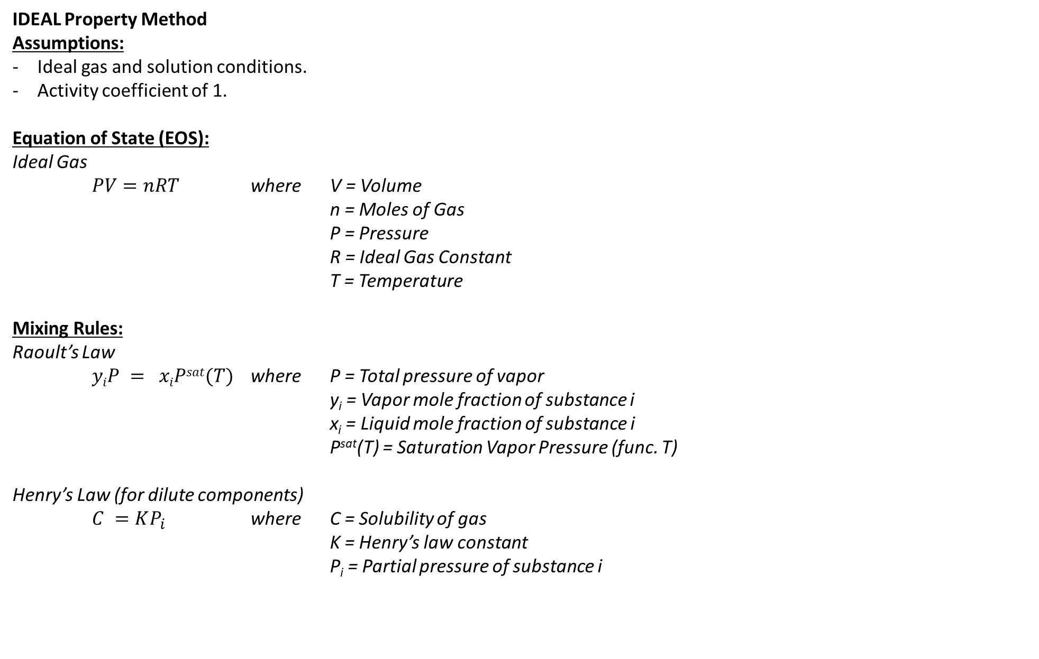
IDEAL Property Method
Assumptions:
Ideal gas and solution conditions.
Activity coefficient of 1.
Equation of State (EOS):
Ideal Gas
$PV=nRT$ where V = Volume
n = Moles of Gas
P = Pressure
R = Ideal Gas Constant
T = Temperature
Mixing Rules:
Raoult’s Law
$yiP = xiPsat(T)$ where P = Total pressure of vapor
y_{i} = Vapor mole fraction of substance i
x_{i} = Liquid mole fraction of substance i
P^{sat}(T) = Saturation Vapor Pressure (func. T)
Henry’s Law (for dilute components)
$C =KP_{i}$ where C = Solubility of gas
K = Henry’s law constant
P_{i} = Partial pressure of substance i

Slide 2
Equation of State Property Methods for High Pressure Hydrocarbon Applications
Examples:

